Slide 1

Urban Air Pollution
By Hanna Schaumberger, Fanxing Xi, Karol Palczynski

Slide 2

ABOUT US
We are the scientific advisory board (Task-Force) to fight air pollution around the world
We are presenting our findings to the politicians from the G12 (without Putin)
Our Mission is to promote air pollution awareness for citizens and provide a unified and world-wide air quality information

Slide 3
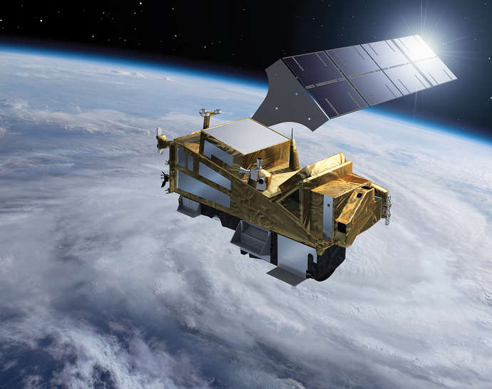
Introduction
Goal: To predict how air quality (PM2.5 particulate matter concentration) changes in places where we don’t have ground-based sensors for measuring
Database : We’ve collected weather data and daily observations from the Sentinel 5P satellite tracking various pollutants in the atmosphere. The data covers the last three months, spanning hundreds of cities across the globe.

Slide 4
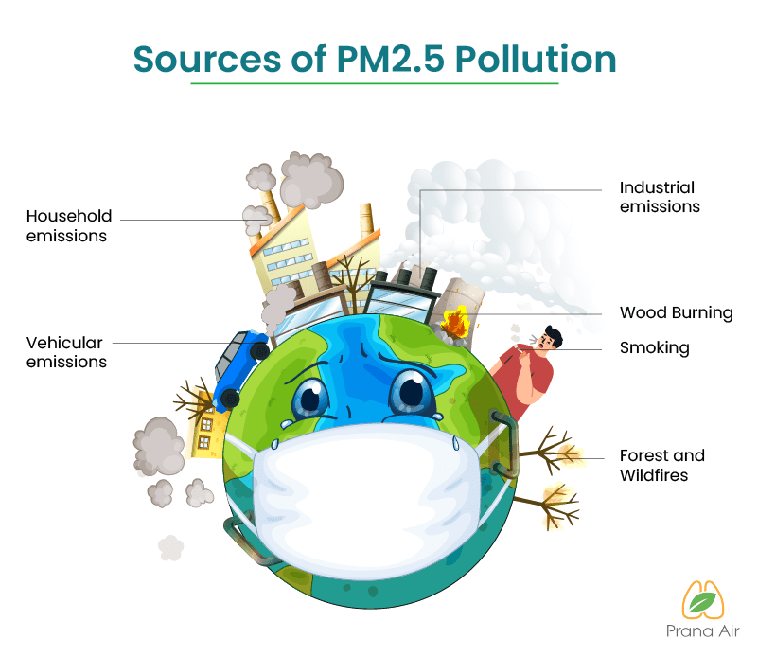
What is PM2.5?

Slide 5
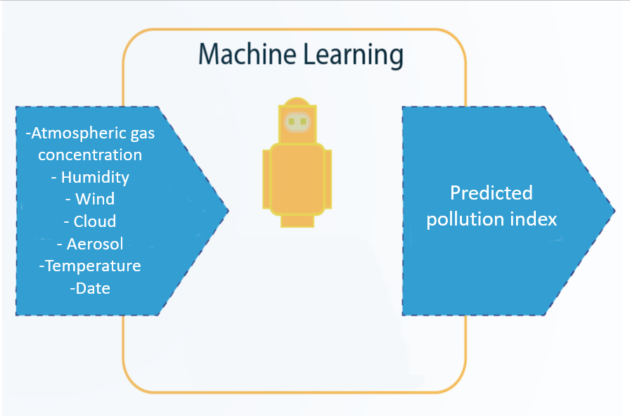
Methodology

Slide 6
Our Observation (EDA)
Data cleaning:
Check the best representation of the data to see the correlations and make hypothesis
Check missing value in each columns: Remove columns with over 80% of missing values
Check outliers: Check distribution of each column, remove outliers > 80% of maximum value

Slide 7
Our Observation (EDA)
Data cleaning
Check the best representation of the data to see the correlations and make hypothesis
Check missing values in each columns: Remove columns with over 80% of missing values
Check outliers: Check the distribution of each column, remove outliers > 80% of maximum value

Slide 8
Hypothesis
Higher gas column densities, higher target value
Higher wind velocity, lower target value?
Aerosol index with target value?
Sensor altitude with target value?
Satellite angle correlates with the target value
Stratospheric column density no correlation with target value
Aerosol index with target value
Humidity correlated non-linearly with target value

Slide 9
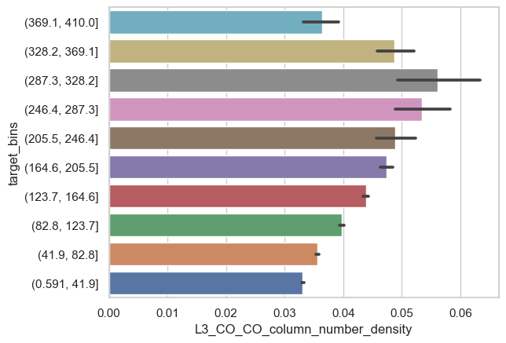

1. Higher gas column densities, higher target value

Slide 10
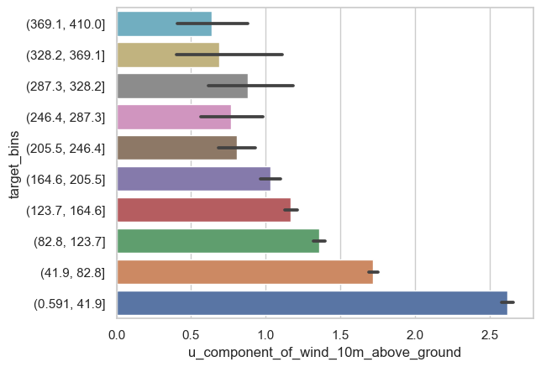
2. Higher wind velocity, lower target value?

Slide 11
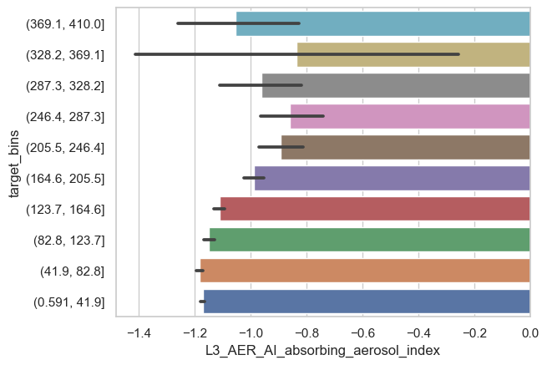
3. The higher Aerosol index the higher the target value?

Slide 12
Machine learning Model
Impute and Scale
Select models: Different regression models were tested; Random forest, LGB regressor, XGB regressor selected based on their performances
Stacking regressor: combining selected models
Grid Search for best parameters: no improvement within limited time

Slide 13
Hypothesis
Hypothesis
Our observation (EDA)
Our Modell
Our Result

